Slide 1

SMART INDIA HACKATHON 2026
TITLE PAGE
Problem Statement ID – 26011
Problem Statement Title- 3D ULPIN Generation and vertical Properties Mapping System
Theme- Smart Automation
PS Category- Software
Team ID-
Team Name (Registered on portal)

Slide 2
IDEA TITLE
Ctrl
Alt
Defeat
THE PROBLEM
2D land records can't uniquely identify ownership in high-rises, basements, and underground utilities — causing airspace disputes, encroachments, and fraud.
OUR SOLUTION
Web-based 3D GIS platform for digital property mapping (ISO 19152 compliant)
Generates a unique 3D ULPIN for every land parcel & floor unit
Maps Building → Floors → Flats/Units vertically in true 3D space
Stores property, owner & spatial data in a centralized spatial database
2D Cadastre: flat polygons only
can't define vertical ownership
3D ULPIN Platform
Volumetric parcel + unique 3D ID + AI collision checks
Legally robust vertical ownership,
fewer disputes, safer infrastructure

Slide 3
TECHNICAL APPROACH
Ctrl
Alt
Defeat
LiDAR Point
Cloud Input
AI Floor
Slicing
3D ULPIN
Generation
Collision
Detection
Digital Twin +
Title Certificate
Methodology: drone/LiDAR data is sliced into floors by AI, each unit gets a 14-digit + vertical-suffix ULPIN, then checked for underground clashes before certificate issuance.
Frontend
Streamlit, Tailwind CSS,
Three.js (WebGL), PyDeck
Backend
Python 3.10+,
Pydantic, Math engine
Database
SQLite3 (Spatial)
+ Pandas
Security
SHA-256 hashing +
QR-verified certificates
3D ULPIN CODE STRUCTURE — 14-digit DILRMP base + ISO 19152 vertical suffix
SS
State
DD
District
SSS
Sub-Dist.
VVV
Village
PPPP
Plot ID
BLD/SUB
Strata
F04/U01
Floor/Basement
K
Checksum
Example: 27-21-101-050-0101-BLD-F04-U01-K (Modulo-36 checksum validates the full code)

Slide 4
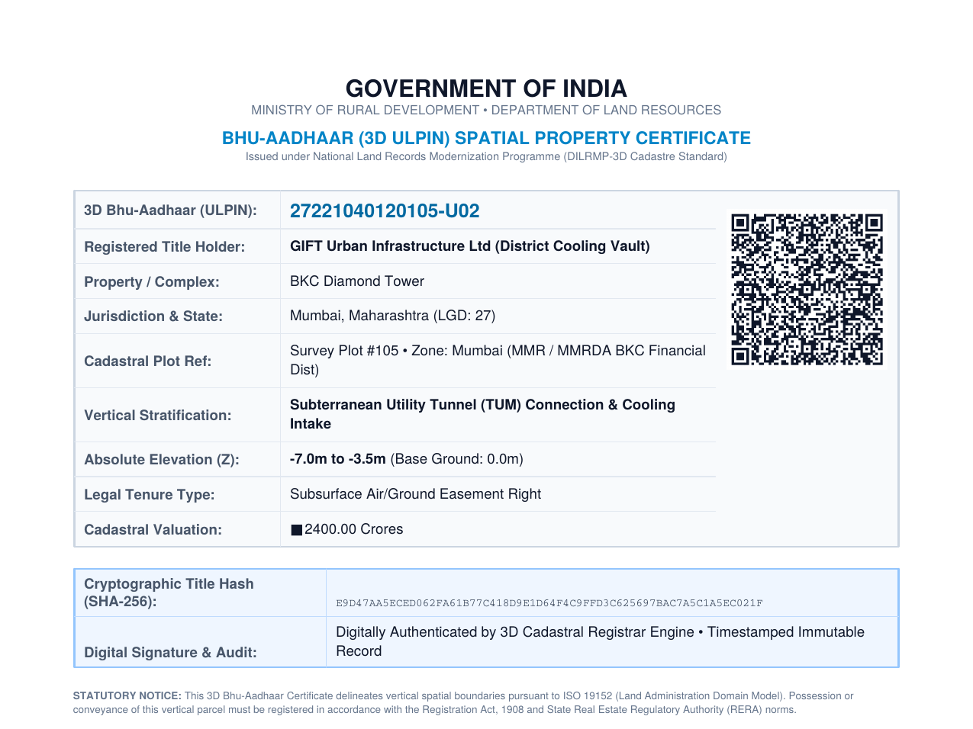
FEASIBILITY AND VIABILITY
Ctrl
Alt
Defeat
TECHNICAL FEASIBILITY
✓
Uses proven AI, GIS & 3D technologies (LiDAR slicing, WebGL, spatial DB)
✓
Generates a 3D ULPIN and maps vertical properties floor-by-floor
✓
Supports interactive 3D visualization and geometry validation
CHALLENGES → SOLUTIONS
Data accuracy & availability
AI-based validation
Example: cryptographically secured 3D ULPIN certificate generated by our working prototype
Source: github.com/pxrkerxd/3d-ulpin-cadastre-sih
Large 3D data processing
Scalable GIS database
System integration & security
Secure role-based access

Slide 5
IMPACT AND BENEFITS
Ctrl
Alt
Defeat
₹26,770 Cr
in multi-storey property value validated across 25 properties in 8 Indian economic corridors
✔
Legal clarity
Legally robust, court-defensible vertical ownership for flats, basements & airspace
✔
Safety
Automated subsurface collision detection prevents encroachment on metro tunnels, utilities
✔
Urban planning
Accurate 3D data supports FSI/GFA compliance checks and dense-city planning
✔
Scalability
Built on DILRMP's ULPIN standard — ready for pan-India rollout & GIS integration

Slide 6
RESEARCH AND REFERENCES
Ctrl
Alt
Defeat
Project Repository
1.Department of Land Resources (DoLR), Government of India
Digital India Land Records Modernization Programme (DILRMP)
DoLR – DILRMP
2.OGC API – Tiles
Standard for accessing geospatial information through tiled APIs.
OGC API – Tiles
3. Survey of India (SoI) — CORS, geospatial standards & elevation/vertical datum references
surveyofindia.gov.in
4.Open Geospatial Consortium (OGC) — CityGML & LandInfra standards for 3D geospatial modelling
OGC Standards
5. ISO 19152 – Land Administration Domain Model — for the 3D land/property administration model.

Slide 7
IMPORTANT INSTRUCTIONS
Please ensure below pointers are met while submitting the Idea PPT:
Kindly keep the maximum slides limit up to six (6). ( Including the title slide)
Try to avoid paragraphs and post your idea in points /diagrams / Infographics /pictures
Keep your explanation precise and easy to understand
Idea should be unique and novel.
You can only use provided template for making the PPT without changing the idea details pointers (mentioned in previous slides).
You need to save the file in PDF and upload the same on portal. No PPT, Word Doc or any other format will be supported.
Note - You can delete this slide (Important Pointers) when you upload the details of your idea on SIH portal.

